Slide 1

Micro Processors & Interfacing
16CS307
Mr. M Krishna Chennakesava Rao,
Asst. Professor, Dept. of ECE,
VFSTR University

Slide 2
Architecture of 8086 Microprocessor
Register organization of 8086
Why Registers ?
To hold data, variables, intermediate results temporarily
for counters (CX ), to store OFFSET address (BX)
Registers in 8086
8086 has Fourteen, 16-bit Registers.
In 8086, registers are categorized into 4 types
1. General Data Registers (4) 2. Segment Registers (4) 3. Flag Register (1)
4. Pointers and Index Registers (5)

Slide 3
Architecture of 8086 Microprocessor
Register organization of 8086
AX | AH | AL | Accumulator
BX | BH | BL | Base → used to store OFFSET for forming physical address
CX | CH | CL | Counter in string & loop instructions
DX | DH | DL | Destination/ Implicit
CS
SS
DS
ES
SP
BP
SI
DI
IP
FLAGS/ PSW
Segment registers
General data register
Pointers and index registers
X specifies 16-bits
H specifies higher 8-bits
L specifies lower 8-bits

Slide 4
Architecture of 8086 Microprocessor
Register organization of 8086
The registers AX, BX, CX, and DX are the general purpose 16-bit registers.
AX Register: Accumulator register consists of two 8-bit registers AL and AH, which
can be combined together and used as a 16- bit register AX. AL in this case contains
the low-order byte of the word, and AH contains the high-order byte.
Accumulator can be used for I/O operations, rotate and string manipulation.
BX Register: This register is mainly used as a base register.
It holds the starting base location of a memory region within a data segment.
It is used as offset storage for forming physical address in case of certain
addressing mode.
CX Register: It is used as default counter or count register in case of string and
loop instructions.
DX Register: Data register can be used as a port number in I/O operations and implicit operand or destination in case of few instructions. In integer 32-bit multiply and divide instruction the DX register contains high-order word of the initial or resulting number.

Slide 5
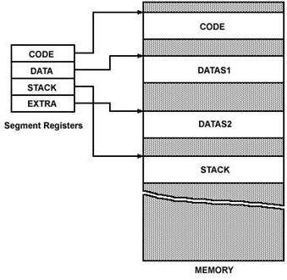
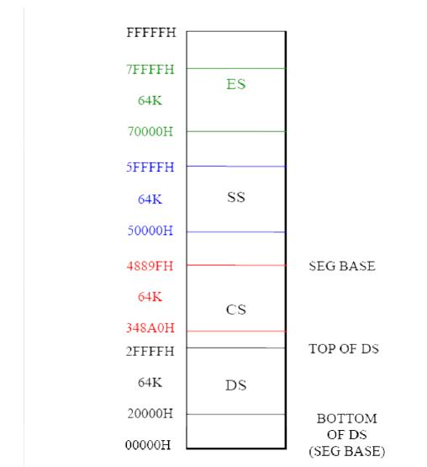
Register organization of 8086 cont’d…
Segment Registers of 8086
8086 processor addresses segmented version of memory ( 2²⁰ =1MB size).
Size of each segment is 64KB. (2²⁰ = 2⁴ 2¹⁶ = 2⁴. 64KB= Sixteen 64KB logical segments)
Physical address =[ Base address x 10 ] + OFFSET address
Memory Segments of 8086
Segment Registers

Slide 6
Register organization of 8086 cont’d…
Pointers and Index Registers of 8086
SP | Stack Pointer | Holds address of the top of the stack. Stores OFFSET within a segment
BP | Base Pointer | Stores OFFSET within a segment
IP | Instruction Pointer | Stores the address of the next instruction to be fetched
SI | Source Index | Stores OFFSET also used as general purpose registers used for string related operations
DI | Destination index

Slide 7
8086 Microprocessor
Architecture
Registers and Special Functions
Register | Name of the Register | Special Function
AX | 16-bit Accumulator | Stores the 16-bit results of arithmetic and logic operations
AL | 8-bit Accumulator | Stores the 8-bit results of arithmetic and logic operations
BX | Base register | Used to hold base value in base addressing mode to access memory data
CX | Count Register | Used to hold the count value in SHIFT, ROTATE and LOOP instructions
DX | Data Register | Used to hold data for multiplication and division operations
SP | Stack Pointer | Used to hold the offset address of top stack memory
BP | Base Pointer | Used to hold the base value in base addressing using SS register to access data from stack memory
SI | Source Index | Used to hold index value of source operand (data) for string instructions
DI | Data Index | Used to hold the index value of destination operand (data) for string operations

Slide 8
Register organization of 8086 cont’d…
Flag Register of 8086
FLAGS/ PSW
U | U | U | U | OF | DF | IF | TF | SF | ZF | U | AC | U | PF | U | CY
9 active flags can be divided into 2 groups.
Conditional flags----6 b) Control flags----3
OV=overflow flag DF=direction flag TF=trap flag IF=interrupt flag SF=sign flag
ZF=zero flag AC=auxiliary carry flag PF=parity flag CY=carry flag
Flag Register determines the current state of the processor.
They are modified automatically by CPU after mathematical operations.
It allows to determine the type of the result.
Determines the conditions to transfer control to other parts of the program.

Slide 9
Architecture
8086 Microprocessor
Execution Unit (EU)
Auxiliary Carry Flag
This is set, if there is a carry from the lowest nibble, i.e, bit three during addition, or borrow for the lowest nibble, i.e, bit three, during subtraction.
Carry Flag
This flag is set, when there is a carry out of MSB in case of addition or a borrow in case of subtraction.
Flag Register
Sign Flag
This flag is set, when the result of any computation is negative
Zero Flag
This flag is set, if the result of the computation or comparison performed by an instruction is zero
Parity Flag
This flag is set to 1, if the lower byte of the result contains even number of 1’s ; for odd number of 1’s set to zero.
15 | 14 | 13 | 12 | 11 | 10 | 9 | 8 | 7 | 6 | 5 | 4 | 3 | 2 | 1 | 0
 |  |  |  | OF | DF | IF | TF | SF | ZF |  | AF |  | PF |  | CF
Over flow Flag
This flag is set, if an overflow occurs, i.e, if the result of a signed operation is large enough to accommodate in a destination register. The result is of more than 7-bits in size in case of 8-bit signed operation and more than 15-bits in size in case of 16-bit sign operations, then the overflow will be set.
Tarp Flag
If this flag is set, the processor enters the single step execution mode by generating internal interrupts after the execution of each instruction
Direction Flag
This is used by string manipulation instructions. If this flag bit is ‘0’, the string is processed beginning from the lowest address to the highest address, i.e., auto incrementing mode. Otherwise, the string is processed from the highest address towards the lowest address, i.e., auto incrementing mode.
Interrupt Flag
Causes the 8086 to recognize external mask interrupts; clearing IF disables these interrupts.

